Slide 1
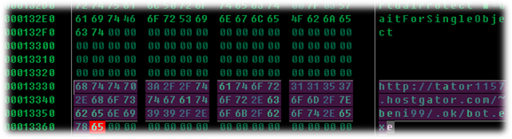
JS Obfuscation
Malware’s best friend
“Everything Published, Talked and/or discussed in this conference is solely based on my personal point of
View, and Does not represent my current, or past employers.”

Slide 2
Next 60 Mins !
Introduction
JS Code Obfuscation
4 Techniques
Demo Basic Obfuscation
Demo Advanced Obfuscation
JS Code de-obfuscation
Demo De-obfuscation
JS obfuscation Examples

Slide 3
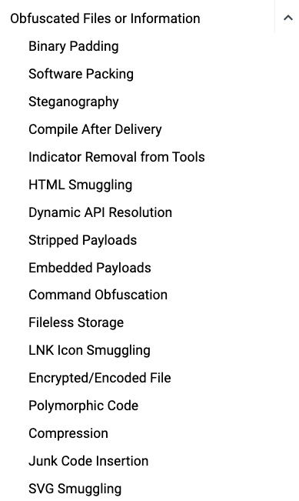
Introduction: A Double-Edged Sword
Origin:
The word "obfuscation" originates from the Latin verb obfuscare, meaning "to darken”.
Process of making something difficult to understand, This technique has both
legitimate and malicious applications.
Legitimate Uses:
Preventing Spam and Phishing: Obfuscating email addresses or sensitive
information can deter automated scrapers and spammers.
Protecting Intellectual Property: Making code harder to reverse-engineer helps
safeguard proprietary algorithms and software.
Preventing Tampering and Cheating: In online gaming or secure systems,
obfuscation can make it more challenging to modify data or exploit vulnerabilities.
Malicious Uses:
Hiding Malicious Intent: Malware authors use obfuscation to disguise the true purpose
of their code, making it harder for humans and security tools to analyze.
Evading Antivirus (AV) and Security Tools: By altering the appearance of their code,
malware can bypass signature-based detection and sandbox analysis.
https://attack.mitre.org/techniques/T1027/

Slide 4
JS Code Obfuscation Techniques Malware Delivery
4 category in JS code obfuscation namely Randomization, Data, Encoding and Logic Obfuscation.
1) Randomization Obfuscation: is a technique where attackers randomly insert or change some elements of the JavaScript code
without changing the semantics of the code. Some of the techniques include:
Whitespace, Comments Randomization
Variable and Function Names Randomization
Clean JS Code | Randomization Obfuscated JS Code
function add(a, b) { return a + b; } console.log(add("security", "sync")); | // rAnDoM CoMmEnT : combining words ... or are we? 🤔 function XyZpQ ( S1 , S2 ) { // aNoThEr CoMmEnT that means nothing! let temp = "us" + "eless"; // junk code let ReS = S1 + S2 ; // random spacing // return value.... maybe? 😉 return ReS ; } // weIrD CoMmEnT wiTh SpAcEs console.log( XyZpQ("security" , "sync") );

Slide 5
2) Data Obfuscation: is a form of data masking where the data is purposely scrambled so that it becomes very difficult for a person to understand the semantics of the code
String
Number
Clean JS Code | Data Obfuscation JS Code
let message = ”Security Sync"; console.log(message); | // String is hidden in pieces let a = ”Se" + ”cur" + ”ity"; let b = String.fromCharCode(115, 121, 110, 99); console.log(a + b);
let num = 50; console.log(num); | // Number is hidden through calculations let num = (100 / 2) + (5 - 5); console.log(num);

Slide 6
3) Encoding Obfuscation: Normally 3 methods are used to encode the original code.
ASCII/Unicode/Hex Coding representations
Customized Encoding Functions and attach a decoding function to decode it during execution
Standard Encryption and Decryption
ASCII/Unicode/Hex Coding | Customized Encoding Functions
let text = String.fromCharCode(115, 121, 110, 99); // "sync” – ASCII Encoding let text = "\u0073\u0079\u006E\u0063"; // "sync” – Unicode Encoding let text = "\x73\x79\x6E\x63"; // "sync” – Hex Encoding | function decode(custom) { return custom .split("-") // Split the string into an array ["120","126","115","104"] .map(code => String.fromCharCode(code - 5)) // Convert each number to a character .join(""); // Join the characters back into a string } let encoded = "120-126-115-104"; // Each letter ASCII + 5 console.log(decode(encoded)); // Output: sync
Standard Encryption and Decryption: "sync" becomes "c3luYw==" People don’t instantly understand Base64 But the browser can decode it easily | let encrypted = btoa("sync"); // encode to Base64 console.log(encrypted); // "c3luYw==" let decrypted = atob(encrypted); console.log(decrypted); // "sync"

Slide 7
4) Logic Obfuscation: This type of obfuscation technique manipulates the execution paths of the JavaScript codes by changing the logic structure without affecting the original semantics.
Insert Irrelevant Instructions
Additional Conditional Branches such as if …else, switch… case, for, while etc.
Clean JS Code | Data Obfuscation JS Code
function add(a, b) { return a + b; } console.log(add(5, 3)); Output: 8 | function addObf(a, b) { // Irrelevant instruction (does nothing) let junk = a * b - a * b + 100 - 100; // Extra conditional branches (never change the result) if (a === 9999) { return "Not possible"; // This never runs } if (false) { console.log("This will never happen"); } // Real logic return a + b; } console.log(addObf(5, 3)); Output: 8

Slide 8
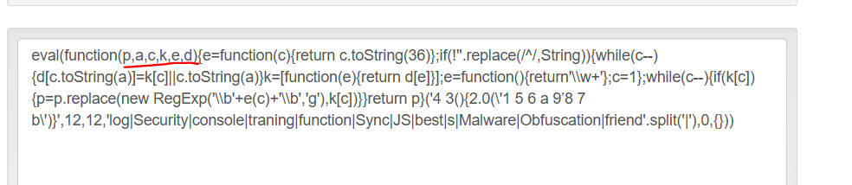
Demo Basic Obfuscation
Code or JS obfuscation is usually not done manually, The above shown are the principle of documented categories, Online tools are used to perform the Obfuscation, we will go though basic to advanced way of Obfuscation Demo here.
There are many tools for various languages that do automated code obfuscation.
Example Java Script code running: https://jsconsole.com/
Minifying Java script code: https://www.toptal.com/developers/javascript-minifier
Packing the Java script code: https://beautifytools.com/javascript-obfuscator.php#

Slide 9
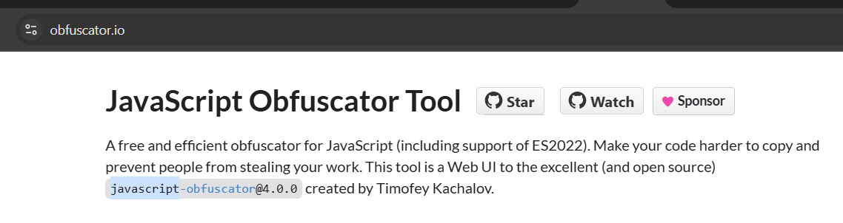
Demo Advanced Obfuscation
Our initial obfuscation steps successfully made the code harder to read and reverse-engineer.
However, clear text strings were still visible within the code.
These readable strings can inadvertently reveal behavior, logic, or internal functionality.
To strengthen protection, we explored advanced obfuscation tools designed to further conceal program intent.

Slide 10
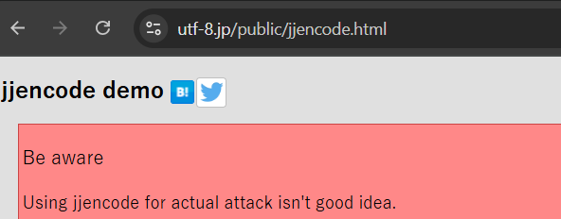
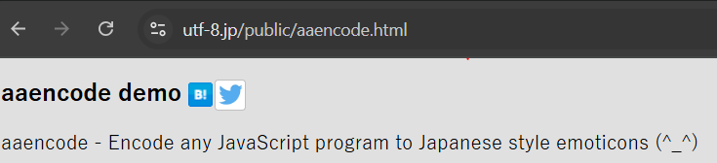
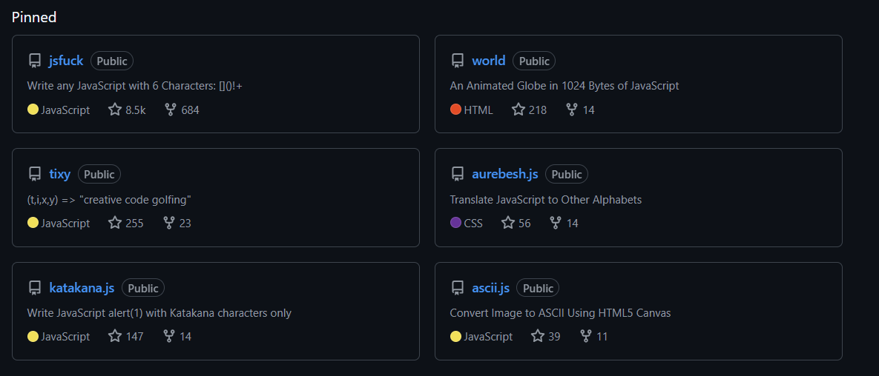
There are many other JavaScript obfuscators, like JJ Encode or AA Encode. However, such obfuscators usually make code execution/compilation very slow, so it is not recommended to be used unless for an obvious reason, like bypassing web filters or restrictions

Slide 11
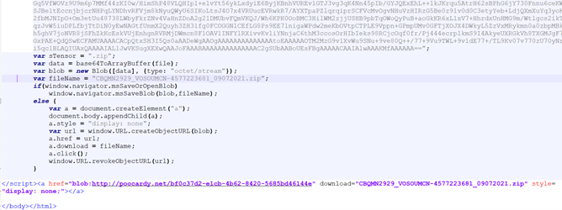
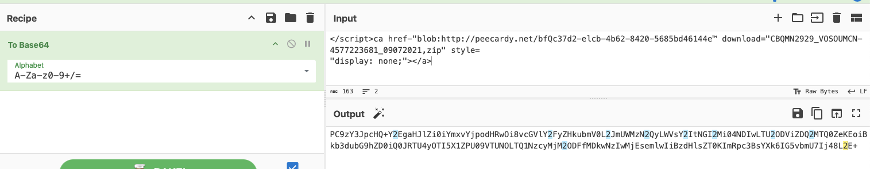
HTML Smuggling Example:
Recently increased spear-phishing campaign for deliver of banking Trojan Mekotio, AsyncRAT/NJRAT and Trickbot deliver payloads.
https://www.microsoft.com/en-us/security/blog/2021/11/11/html-smuggling-surges-highly-evasive-loader-technique-increasingly-used-in-banking-malware-targeted-attacks/

Slide 12
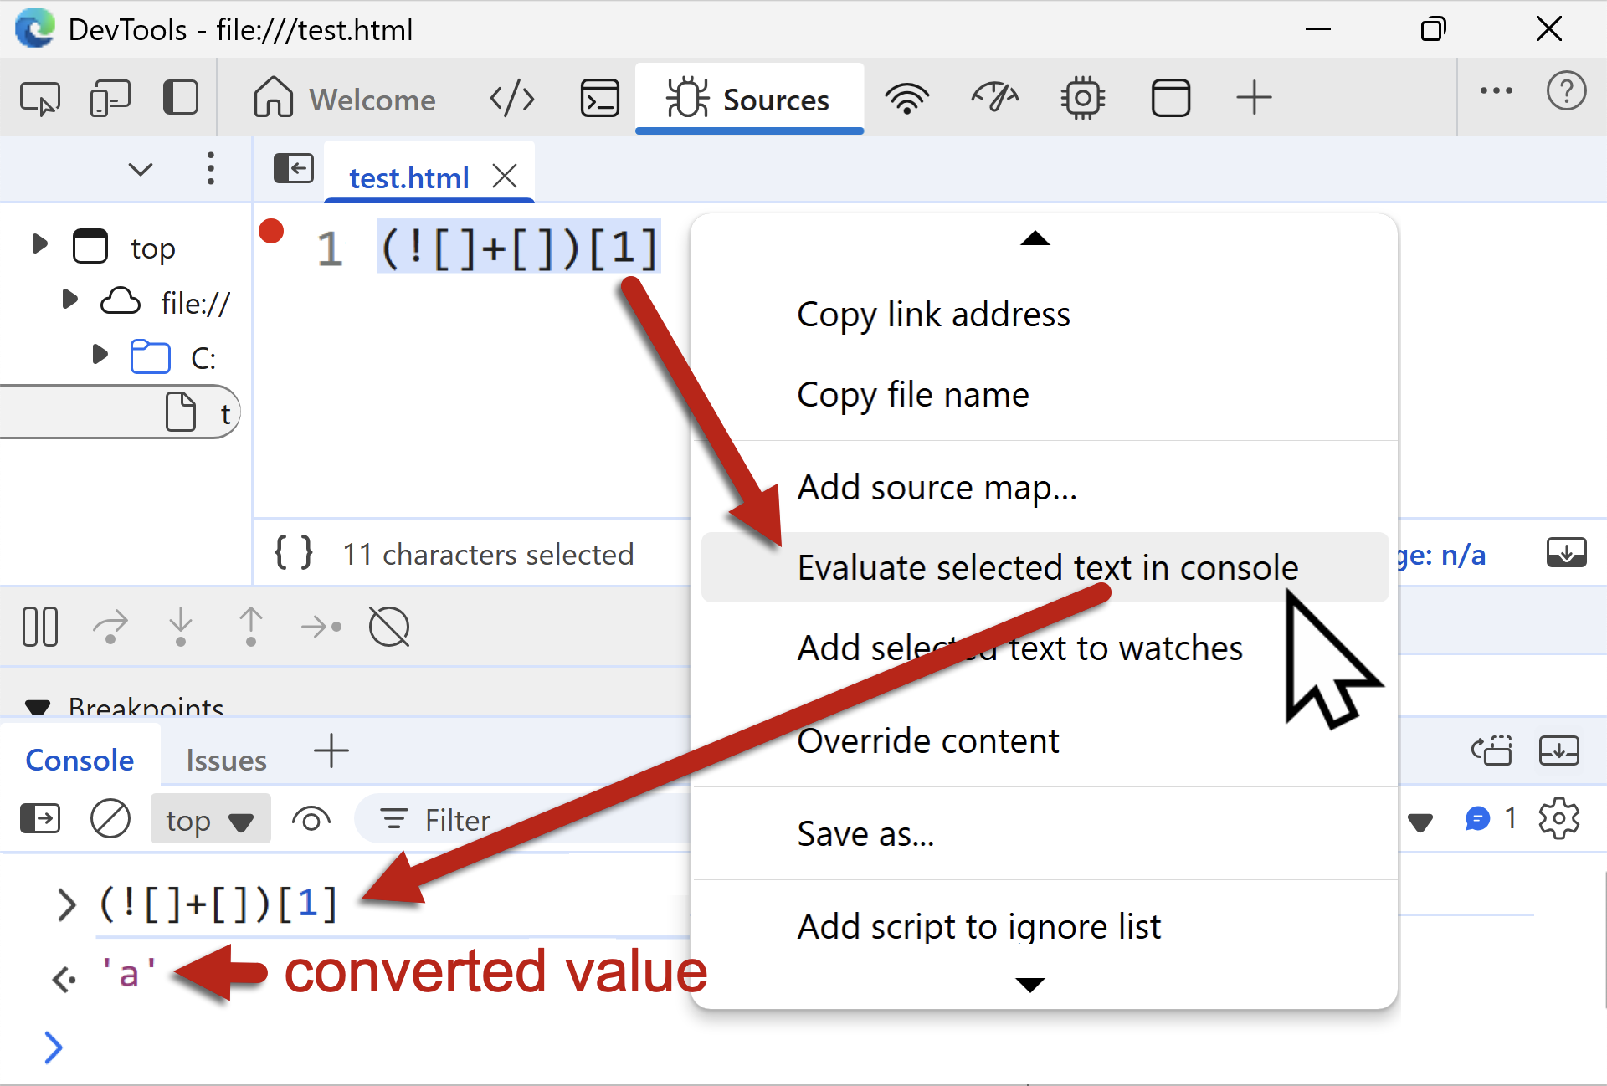
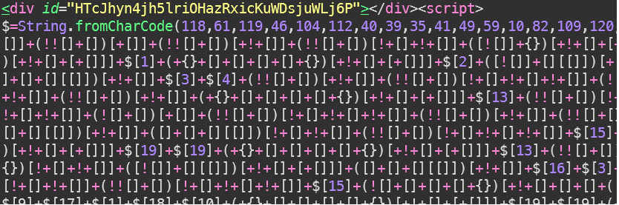
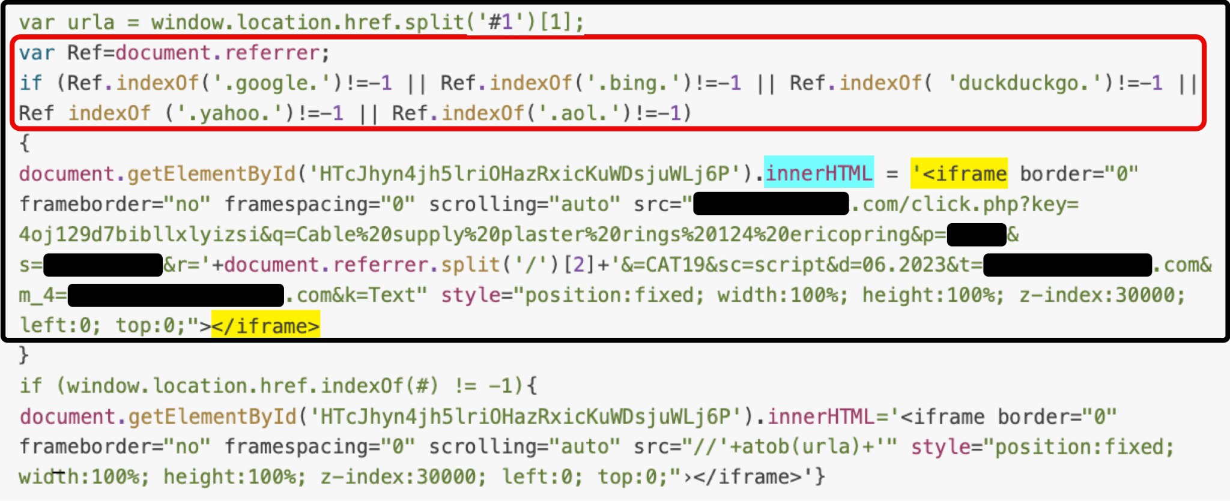
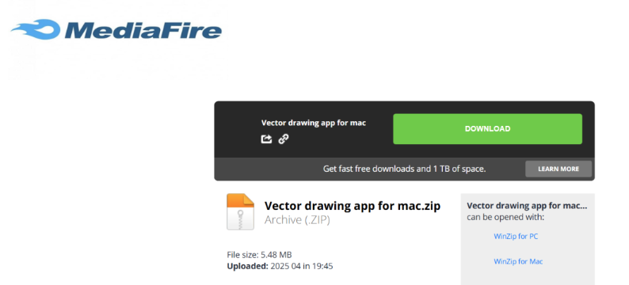
JSFireTruck Obfuscation Technique
https://unit42.paloaltonetworks.com/malicious-javascript-using-jsfiretruck-as-obfuscation/

Slide 13
References:
https://www.devzery.com/post/obfuscate-js
https://www.cse.psu.edu/~sxz16/papers/malware.pdf
https://tryhackme.com/room/obfuscationprinciples
https://tech-zealots.com/malware-analysis/javascript-code-obfuscation-techniques/
https://www.microsoft.com/en-us/security/blog/2021/11/11/html-smuggling-surges-highly-evasive-loader-technique-increasingly-used-in-banking-malware-targeted-attacks/
https://unit42.paloaltonetworks.com/malicious-javascript-using-jsfiretruck-as-obfuscation/
https://github.com/aemkei
https://utf-8.jp/public/jjencode.html
https://utf-8.jp/public/aaencode.html
https://gchq.github.io/CyberChef/

Slide 14

Anybody got any
Questions?

